Slide 1

WS 4 – Combating Antibiotic Resistance
Why Do we Need Novel Antibiotics? – The ID Physicians Perspective
Mathias W. Pletz, MD
Jena University Hospital, Germany

Slide 2
The Medical Need for Novel Antibiotic
The need for effective antibiotics is increasing
Resistance is inevitable
We need a contineous pipeline of novel antibiotics

Slide 3
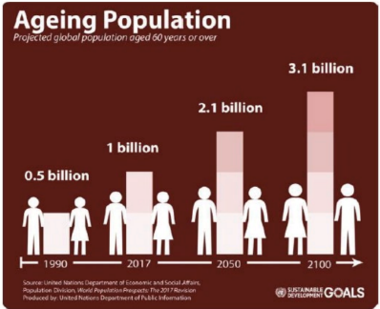
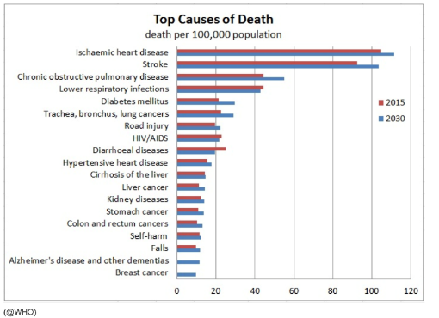
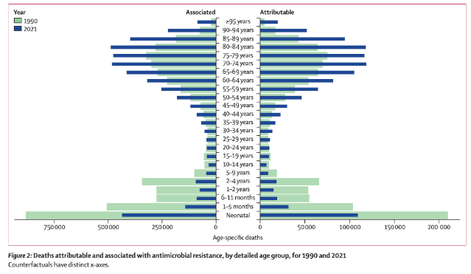
Increasing Need for Antibiotics – 1) The Aging Population
Aging increases the risk of bacterial infections like pneumonia – rising AMR burden in the elderly.
Antimicrobial Resistance Collaborators, Lancet Infect Dis 2024

Slide 4
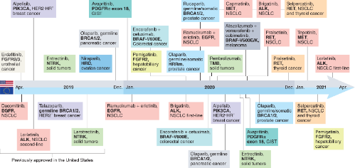
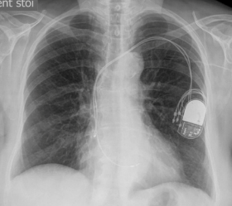
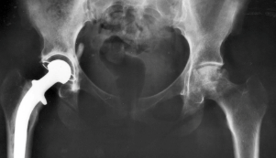
Increasing Need for Antibiotics – 2) Medical Progress
.
Medical progress – e.g. oncology and implants - saves lives, but creates immunocompromised patients vulnerable to infections who rely on effective antibiotics.
Novel Cancer Therapeutics – Last 3 Years Pace Makers Artificial Joints

Slide 5

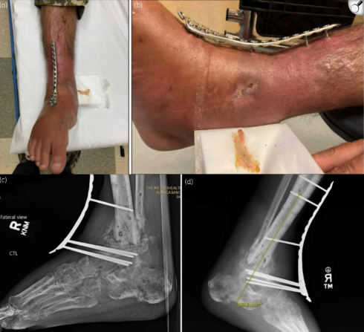
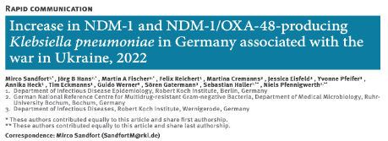
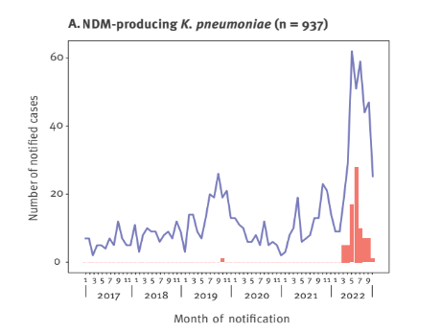
Increasing Need for Antibiotics – 3) Armed Conflicts

Slide 6
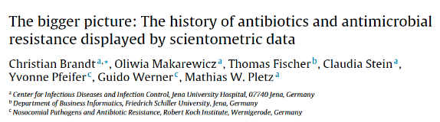
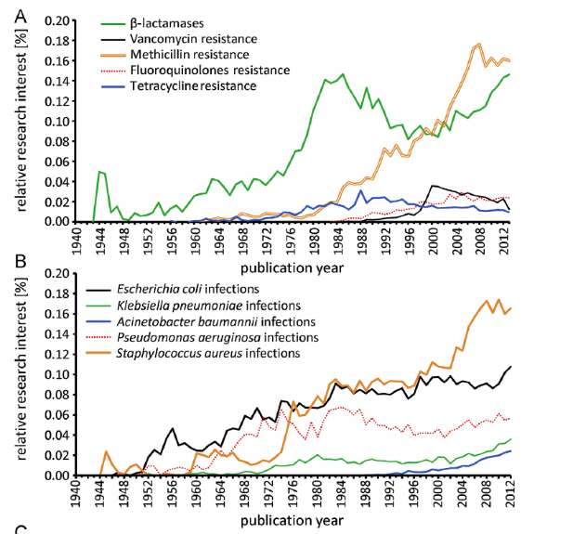
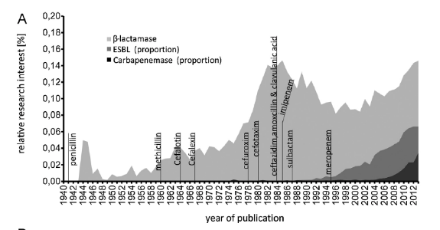
How Long Do Antibiotics Last?

Slide 7
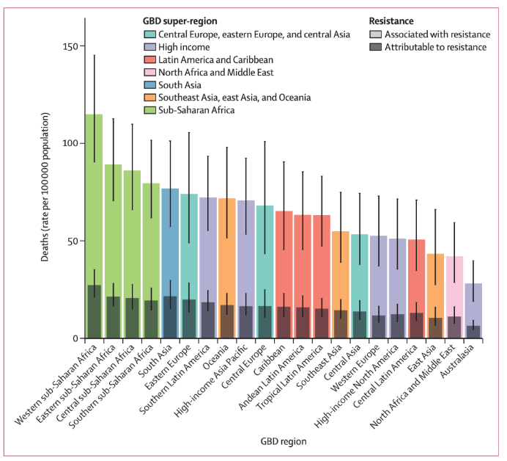
„Silent Pandemic“
1.1 Million Deaths
Directly due to AMR in 2021
Antimicrobial Resistance Collaborators, Lancet Infect Dis 2024

Slide 8
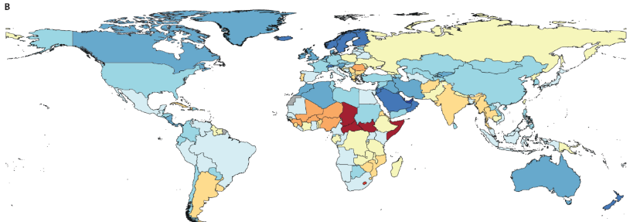
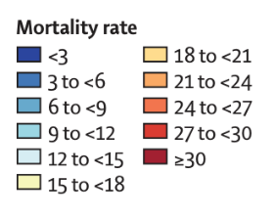
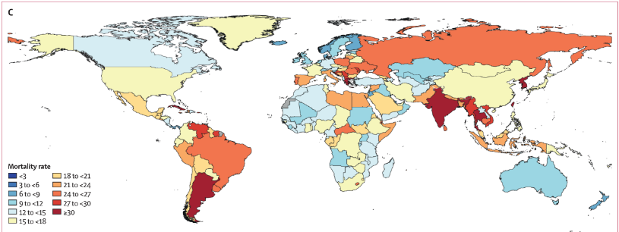
AMR Deaths to be expected in 2050
2021
1.1 Mio Deaths/a
AMR Deaths /100.000/a
2050
1.9 Mio Deaths/a
Antimicrobial Resistance Collaborators, Lancet Infect Dis 2024

Slide 9
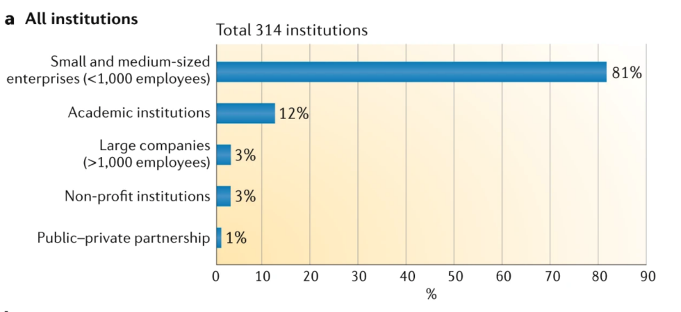
Development of Novel Antibiotics? – Mostly Small -and Economically Vulnerable – Companies
Theuretzbacher, Nature Rev Microbiol 2019

