Slide 1


Improving the economic environment of AMR R&D
October 12, 2025
Marc Gitzinger – World Health Summit

Slide 2

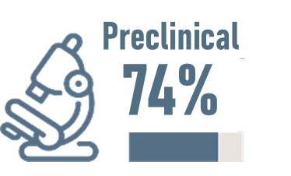
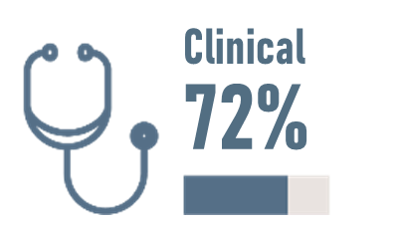


Incentives to support AMR innovation: why does it matter?
The portfolio of nextgen antimicrobials is thin and developed by fragile SMEs
Pharma companies from Top 50 stopped developing antimicrobials
Products developed by SMEs
SMEs indicators of sustainability
18/50
54%
59%
2/50
1990
2020
Have less than 9 employees
Have a runway
< 1 year
The whole pipeline is only hanging by a thread
Source: 2023 WHO Antibacterial pipeline update, available here ; The BEAM barometer 2025, available here

Slide 3


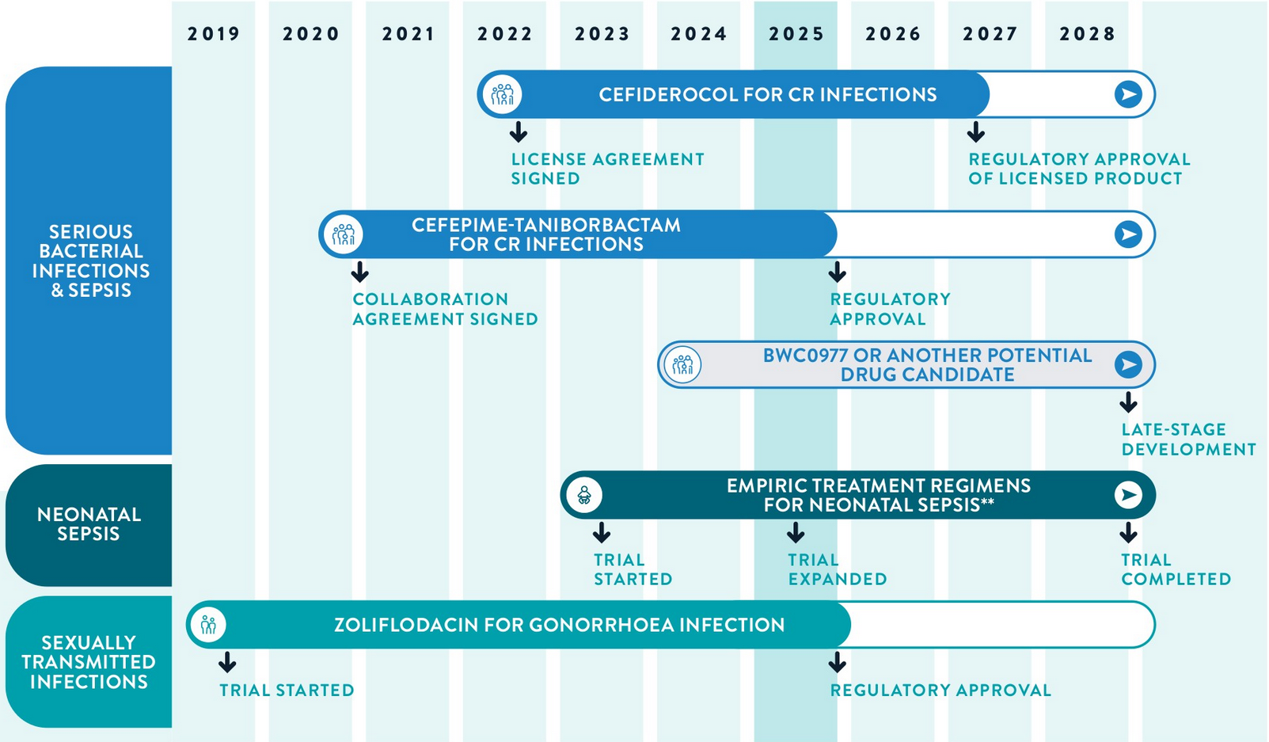
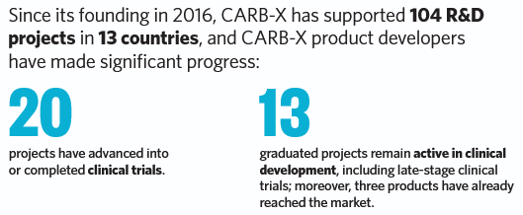

Public-private partnerships support innovation and access
Stewardship and access plans at early clinical stage
Unlocking full potential requires PULL incentives

Slide 4






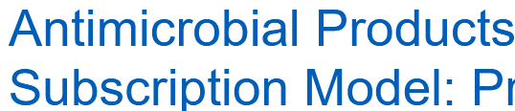


Progress towards impactful PULL incentives
€
+ ??
UK model: the lighthouse in the fog
Italian reimbursement model
European toolbox in the making?
Up to £23.7m/year subscription for up to 16 years
AWaRe/BPPL antibiotics are reimbursed through a dedicated €100M fund
Proposals for transferable exclusivity extension voucher, revenue guarantee…
Sufficient and predictable size to reward innovation and guarantee access (« fair share »)
Fair share, though not delinked from sales
Sufficient size? Predictability?
More is urgently needed to make a real change

Slide 5

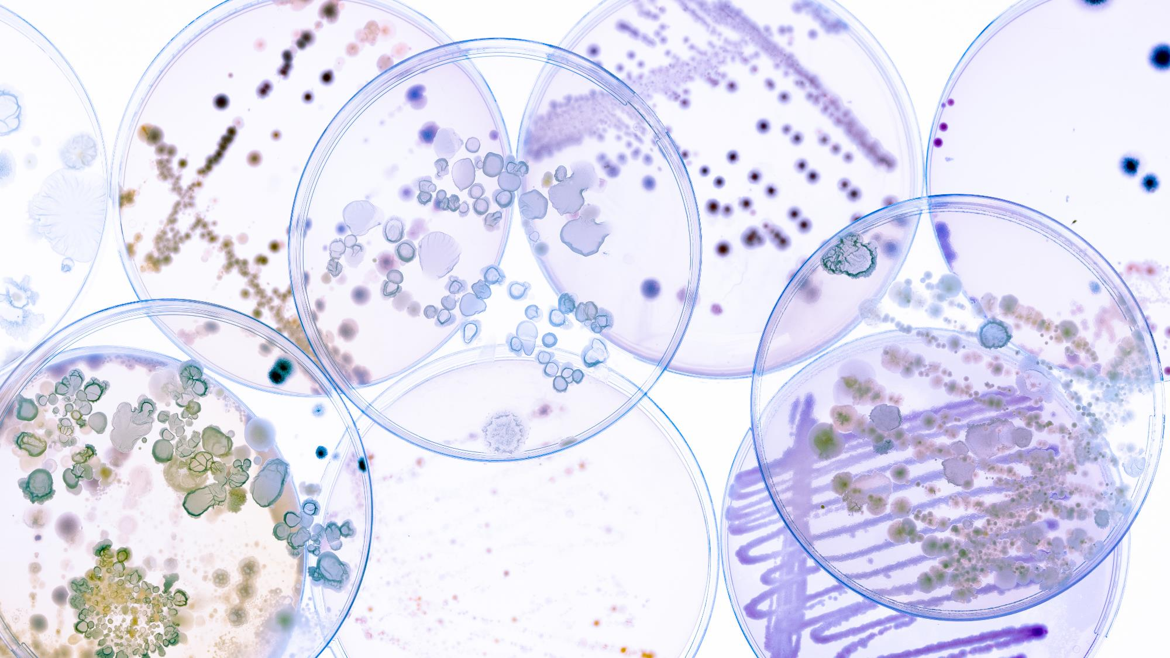


Thank You
@AllianceBEAM
BEAM Alliance page
https://beam-alliance.eu

