Slide 1
Combating Antibiotic Resistance: The Role of Market Incentives in Europe for the Development of New Therapies
October 12, 2025
Shionogi & Co., Ltd.
Vice Chair
Takuko Sawada
MEETING WITH
PROPERTY OF SHIONOGI & CO., LTD.

Slide 2







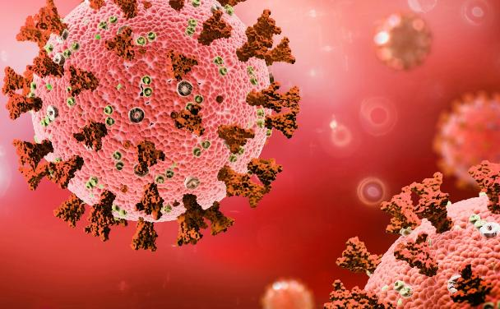

Shionogi is a Global Leader in Infectious Diseases
³
Shionogi invests heavily in R&D to address the most critical unmet needs across a wide range of infectious diseases^{1,2}
Multidrug-resistant
bacterial infections
AIDS
Influenza
COVID-19
Malaria
Fungal infections
Respiratory Syncytial Virus
1. ‌‌R&D Vision and Strategy. Shionogi.com. Published 2024. Accessed November 5, 2024. https://www.shionogi.com/global/en/innovation/randd/overview-of-randd/randd-vision-and-strategy.html
2. Research Topics. Shionogi.com. Published 2019. Accessed November 6, 2024. https://www.shionogi.com/global/en/innovation/randd/drug-discovery/our-strength-and-new-modality.html
3. Pipeline. Shionogi.com. Published 2024. Accessed November 5, 2024. https://www.shionogi.com/global/en/innovation/pipeline.html
AIDS (Acquired Immunodeficiency Syndrome); COVID-19 (coronavirus disease 2019); R&D (research and development); RSV (Respiratory Syncytial Virus).
PROPERTY OF SHIONOGI & CO., LTD.
Notes:
Shionogi’s commitment to fighting infectious disease is illustrated by the wide range of diseases we have invested R&D resources in to address the most critical diseases. We have R&D programmes and therapies in all of the disease areas you can see here

Slide 3
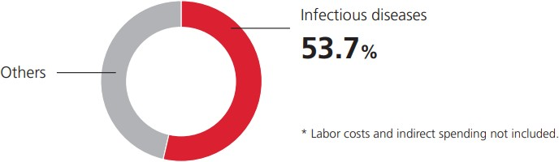
Shionogi’s commitment to infectious diseases
Providing therapeutic drugs developed in-house Committed to infectious diseases for over 60 years based on our ability to create innovation and our expertise in infectious diseases
Main infectious disease drugs developed in-house
1959
1988
1997
2005
2014
2018
2020
The sulfonamide drug “Sulfamethoxazole”
The oxacephem antibiotic “Flomoxef”
The cephem antibiotic “Cefcapene”
The carbapenem antibiotic “Doripenem”
The HIV treatment “Dolutegravir”
The anti-influenza virus drug “Baloxavir”
A siderophore cephalosporin antibiotic “Cefiderocol”
SHIONOGI has been researching and developing innovative treatments for infectious diseases for more than 60 years
SHIONOGI is currently investing more than 50% of R&D spend into infectious diseases
Proportion of R&D expenses for the infectious disease area (FY2021)
2021
The long-acting HIV treatment “Cabotegravir”
The antiviral pill for COVID-19 “Ensitrelvir”
2022
PROPERTY OF SHIONOGI & CO., LTD.
1.Sustainability Meeting. Page 17.; Shionogi & Co., Ltd. 2023. Accessed November 5, 2024. https://www.shionogi.com/content/dam/shionogi/global/investors/ir-library/presentation/2023/e20231019.pdf

Slide 4






The market for new antibiotics is broken
INVESTOR
LOSS
2017
2018
2019
2020
2021
2022
2023
FDA
$593M
FDA
$504M
FDA
$550M
FD
$162M
FDA
FDA
$507M
Cumulative loss for private investors: >$2.3 billion

Slide 5
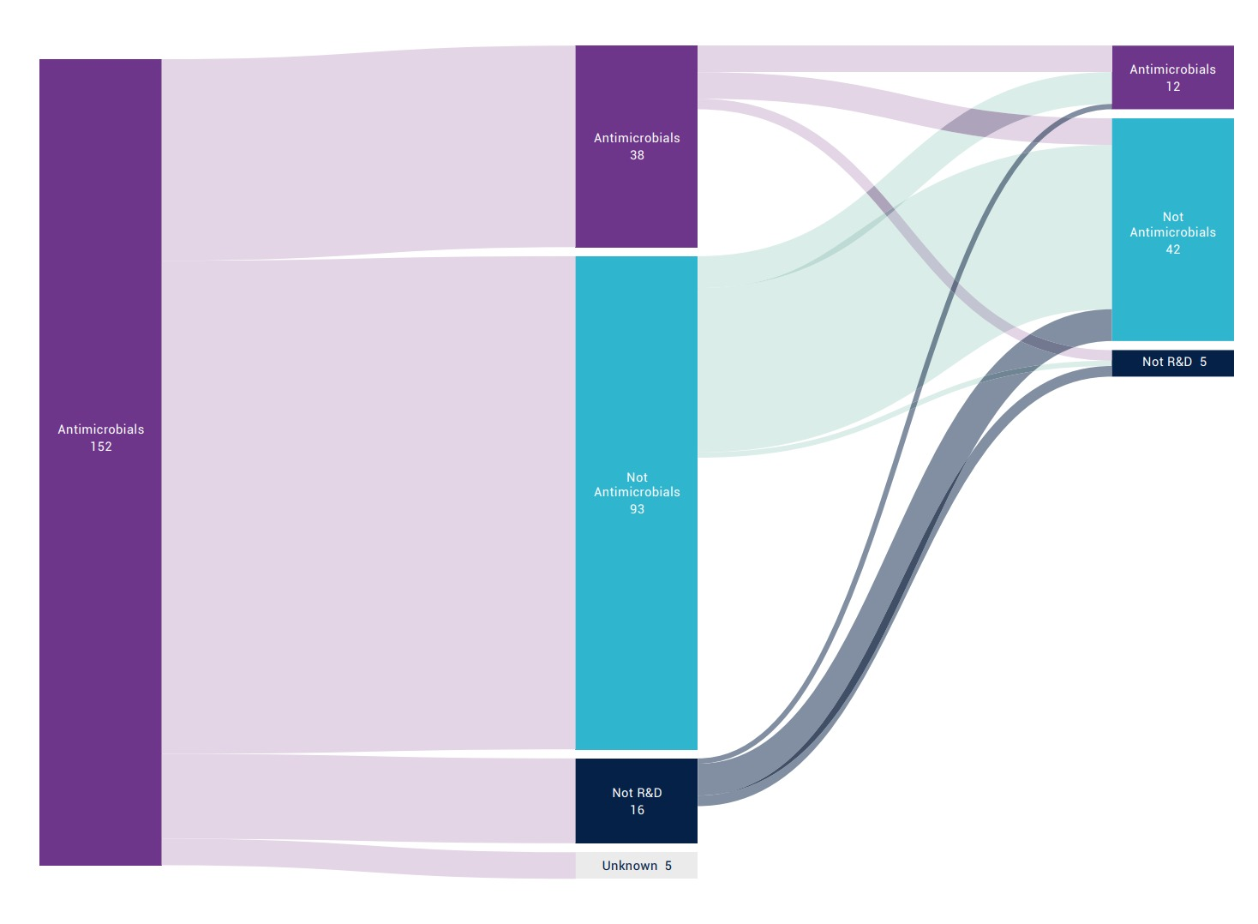
Researchers are leaving and are not replaced
AMR R&D
AMR
R&D
38
12
Job changes of AMR researchers after their small antibacterial companies run into financial trouble in recent years
Other
R&D
42
AMR
R&D
152
Not R&D 5
Other
R&D
93
Not R&D
16
Source: https://www.amrindustryalliance.org/mediaroom/leaving-the-lab-tracking-the-decline-in-amr-rd-professionals/
Unknown 5

Slide 6
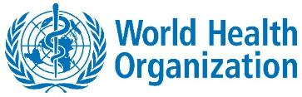
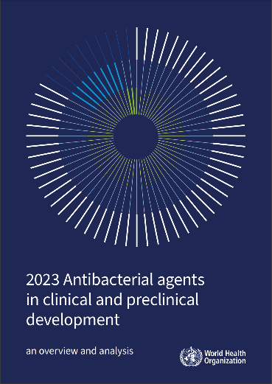
Consequence : Few new drugs
“Overall, antibacterial agents in the clinical pipeline combined with those approved in the last six years are still insufficient to tackle the ever growing threat of the emergence and spread of drug-resistant infections.”
Source: https://www.who.int/publications/i/item/9789240094000

Slide 7
Current Antibiotic Pipeline & Barriers to Development
Current Antibiotic Pipeline
97
12
4
Antibiotics in clinical development
Innovative candidates
Active against critical pathogens
Currently globally, but only 27 target WHO priority pathogens
Of the 32 antibiotics under development to address bacterial priority pathogen list infections
Of the 12 innovative candidates are active against at least one WHO 'critical' pathogen
High attrition rates persist, with only one in 15 drugs in existing classes and one in 30 drugs in new classes reaching patients.
Barriers
Scientific Challenges
Economic Challenges
Human resource challenges
Antibiotic development faces major challenges including limited new targets, rapid bacterial resistance, penetration barriers in Gram-negative bacteria, and balancing efficacy with safety concerns.
Antibiotic development is hindered by poor commercial returns, high R&D costs, regulatory complexity, and short patent exclusivity before generics enter
AMR research faces a talent crisis, with sharp declines in scientists, publications, and patents, and most researchers exiting the field after program shutdowns.
Notes:
Source:
World Health Organization. WHO releases report on state of development of antibacterials. June 14, 2024. Available from: https://www.who.int/news/item/14-06-2024-who-releases-report-on-state-of-development-of-antibacterials
Kostyanev T, Piddock LJV, Rodríguez-Baño J, et al. Addressing urgent priorities in antibiotic development: insights from WHO 2023 antibacterial clinical pipeline analyses. The Lancet Microbe. 2024;5(11):100960. doi: 10.1016/S2666-5247(24)00260-X
Butler MS, Paterson DL. Antibiotics in the clinical pipeline as of December 2022. The Journal of Antibiotics. 2023;77(1):1-24. doi: 10.1038/s41429-023-00629-8
Karlowsky JA, Lob SH, Young K, et al. Multi-year analysis of the global preclinical antibacterial pipeline: trends and gaps. Antimicrobial Agents and Chemotherapy. 2024;68(7):e00535-24. doi: 10.1128/aac.00535-24
World Health Organization. Lack of innovation set to undermine antibiotic performance and health gains. June 22, 2022. Available from: https://www.who.int/news/item/22-06-2022-lack-of-innovation-set-to-undermine-antibiotic-performance-and-health-gains

Slide 8
Economic Impact of AMR and investment in antibiotics
$412B
$443B
$7-13
Additional healthcare expenditures annually
Workforce participation and productivity losses
Return on investment
Expected for every US$1 invested in critical AMR interventions
World Bank estimates for unchecked AMR
Annual economic burden beyond healthcare costs
The economic burden of AMR extends beyond healthcare costs. However, implementing critical AMR interventions offers significant returns.
Notes:
Source:
World Health Organization. New WHO report presents progress in G7 countries in tackling antibiotic pipeline crisis. October 14, 2024. Available from: https://www.who.int/news/item/14-10-2024-new-who-report-presents-progress-in-g7-countries-in-tackling-antibiotic-pipeline-crisis
World Bank Group. Antimicrobial Resistance (AMR). November 2024. Available from: https://www.worldbank.org/en/topic/health/brief/antimicrobial-resistance-amr

Slide 9
Creating incentives for innovation and access is key – the UK subscription model
Collaborative solutions: partnerships with governments and health bodies are essential for incentive models tailored to local systems.
Pioneering innovation: created by the UK Government, the world’s first antibiotic subscription model sets a global precedent. Pilot done, permanent model about to start.
Proven success: fixed annual payments delinked from sales, paired with stewardship, ensure responsible antibiotic use.
How it works: the NHS pays a yearly fee of up to 20 M pounds for guaranteed access to critical antibiotics, ensuring availability and rewarding innovation.
Gov.-ABPI working group established
Subscription pilot scheme announced
Subscription pilot launched
2 products selected for pilot
Pilot implemented from July
New “permanent” scheme consultation
New scheme implementation
2016
2019
2020
2021
2022
2023
2024

Slide 10

Innovative policy in practice: Italy innovation fund
Collaborative regulation: developed by the Italian government, AIFA, industry, and stakeholders, to enhance antibiotic access and innovation.
Funding access: automatically includes all reserve antibiotics and WHO-priority agents in the €100M Innovative Medicines Fund.
Tax exemptions: provides full payback tax exemptions for the patent life of these antibiotics, easing financial burdens on manufacturers.
Accelerated access: enables immediate reimbursement and regional inclusion, ensuring faster patient access to critical treatments.

Slide 11
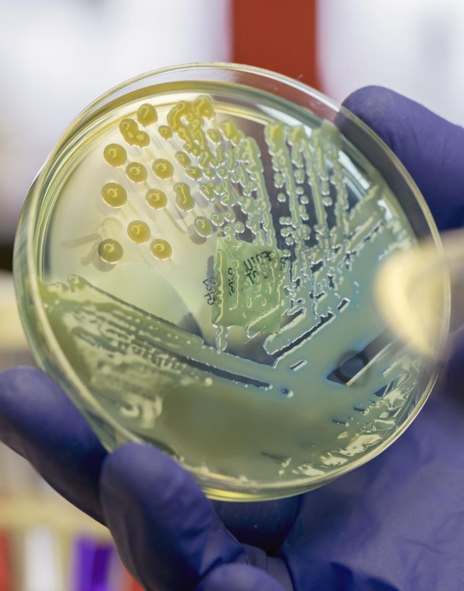
Expanding global access: delivering solutions through strategic partnerships
Shionogi’s commitment: advancing antibiotic access in LMICs through partnerships with GARDP and CHAI, while fostering antimicrobial innovation in Europe.
Landmark collaboration: partnered with GARDP and CHAI to expand cefiderocol access in 135 underserved countries.
Equitable access model: GARDP will manufacture and commercialise cefiderocol via sub-licensees, setting a global standard for future antibiotic initiatives.

Slide 12





Driving toward patient access
Transfer technology: Shionogi, facilitated by CHAI, shares technical information with Orchid
Set up manufacturing process and test batches
Patient access
in select countries
Build new finished dosage form facility & procure specialized equipment to manufacture cefiderocol
MANUFACTURING
REGULATORY
Submit regulatory dossier for WHO Prequalification
Notes:
N.B. WHO PQ timelines are significant, because it will take some time and because it is not within the collaboration team’s control. Nonetheless, we don’t want to emphasize this point because we need WHO PQ’s ongoing support.
Patient access may be initiated as early as 2027-2028 – to be discussed/revalidated by project partners at the March JSC meeting.

Slide 13
Supporting appropriate use:
Focus on evidence generation and implementation
Evidence to inform use cases
Develop and test models of care to support appropriate use
Use lessons learned to support scale up
Challenge-set/surveillance studies to understand cefiderocol activity locally
Facility assessment to inform site selection for phased introduction
Support introduction of the WHO operational guidance for Reserve antibiotic introduction via communities of practice
Understanding local formularies to inform cefiderocol use case
Studies and demonstration projects to assess guidelines and training
Develop a cefiderocol-specific uptake toolkit, including PV, and train additional countries in its use
Support country leaders to develop guidelines that include cefiderocol
Hub-and-spoke models to support lower level hospitals for future uptake

Slide 14
Sustained investment in antibiotic innovation is essential to tackle AMR
AMR remains one of the greatest global health threats, already causing thousands of deaths in Europe and over 1 million worldwide, requiring urgent action.
Shionogi continues to invest across the full antimicrobial lifecycle — from discovery to global access — ensuring long-term impact.
Innovate incentive models, such as the UK subscription model and the Italian Innovation Fund are crucial to attract young researchers and sustainable investment in R&D.
Public-Private Partnerships are essential to ensure access and stewardship in LMIC aligning with the UN Sustainable Development Goals and the 2016 Davos Declaration on AMR.

Slide 15
Thank you for your attention!

